Slide 1


PESTICIDE SPRINKLER WITH IOT BASED SECURITY
by
Bhoomika C P 4GW19EE005
Prakruthi K N 4GW19EE026
Rakshitha G 4GW19EE030
Vidyashree K 4GW19EE041
Under the Guidance of
Smt. SHILPASHRI V N
Assistant Professor
Dept. of EEE, GSSSIETW, Mysuru
Department of Electrical & Electronics Engineering
Project Phase –II (18EEP83)
Progress I
PRESENTATION ON

Slide 2
SUMMARY OF PHASE-1
In phase-1 progress 1&2 we discussed about
Literature survey
Objectives
Scope of the project
Methodology
Block diagram
Components used
References

Slide 3
HARDWARE COMPONENTS
SL.NO | COMPONENT NAME | SPECIFICATION | NO. OF COMPONENT
01 | Arduino Board | Atmega 2560 | 1
02 | PIR | Infrared sensor | 1
03 | CAR kit | --- | 1
04 | DC motor | ESP8266 | 1
05 | LN298N Motordrivers |  | 1
06 | FTDI Module | SPST reset switch | 1
07 | Jumpers | DS18B20 | 1

Slide 4
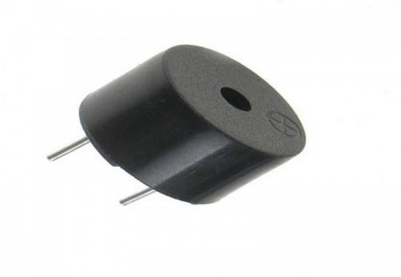
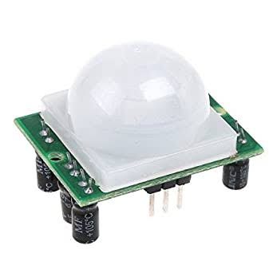
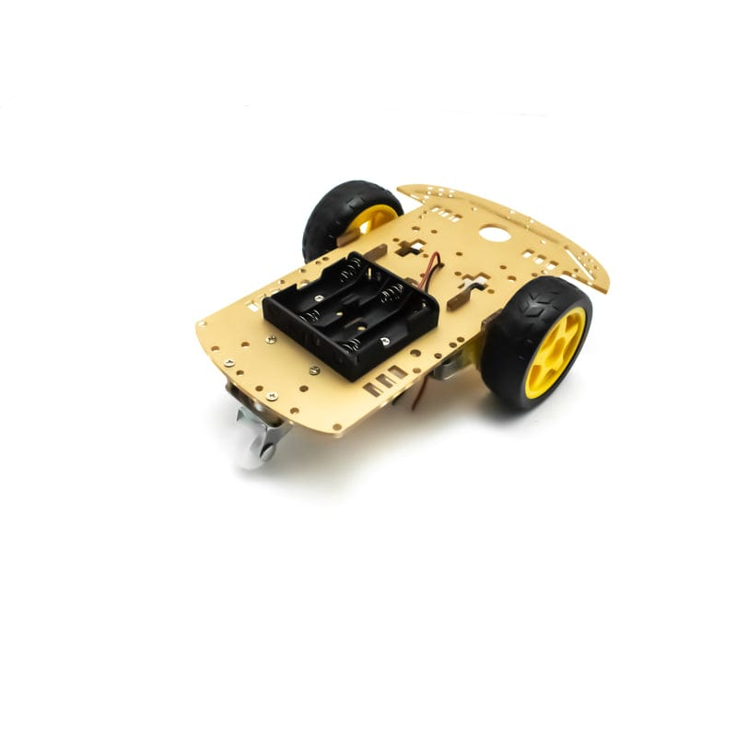
BUZZER
PIR SENSORS
CAR KIT

Slide 5
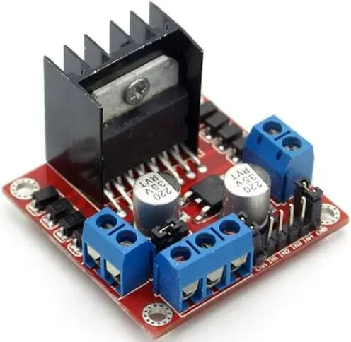
Features & Specifications
Driver Model: L298N 2A
Driver Chip: Double H Bridge L298N
Motor Supply Voltage (Maximum): 46V
Motor Supply Current (Maximum): 2A
Driver Voltage: 5-35V
Driver Current:2A
Maximum Power (W): 25W
LN298 MOTOR DRIVER

Slide 6
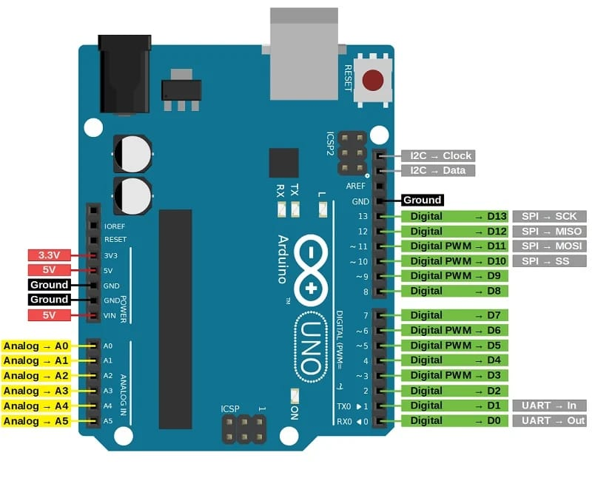
Specifications of Arduino
The operating voltage is 5V.
The recommended input voltage will range from 7v to 12V.
The input voltage ranges from 6v to 20V.
Digital input/output pins are 14.
Analog i/p pins are 6.
DC Current for each input/output pin is 40 mA.
DC Current for 3.3V Pin is 50 mA.
Flash Memory is 32 KB.

Slide 7
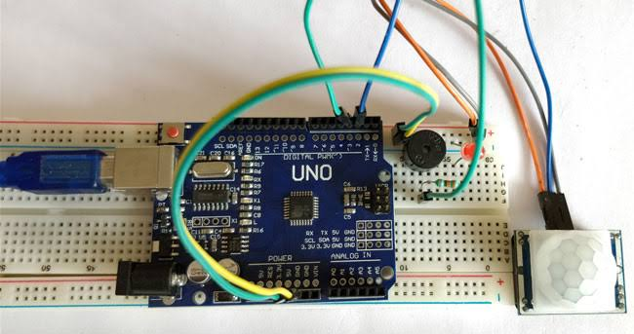

Slide 8
REVIEW PAPERS
Applied for SPP Karnataka State Council for Science and Technology (KSCST) 46th series.
Registered for Shakthistavar-2023 Virtual Project Exhibition organized by Department of Electrical & Electronics engineering in association with IEEE power .
Paper is in under process.

Slide 9


